Slide 1
FHIR Questionnaires and Structured Data Capture
Lloyd McKenzie
May 9, 2023

Slide 2

Who am I?
Name: Lloyd McKenzie
Company: Dogwood Health Consulting
Background:
One of FHIR’s 3 initial editors
Co-chair FHIR Management Group and FHIR-Infrastructure
HL7 Fellow
Lead for both the ONC and international FHIR SDC projects
lloyd@dogwoodhealthconsulting.com

Slide 3
Who are you?
Name
Organization
Role
Experience with FHIR
What will make this morning most valuable to you?

Slide 4
This presentation
Can be downloaded here:
https://github.com/FHIR/documents/tree/master/presentations/2023-05%20Tutorials
Is licensed for use under the Creative Commons, specifically:
Creative Commons Attribution 3.0 Unported License
(Do with it as you wish, so long as you give credit

Slide 5
Credit
These slides include content from Brian Postlethwaite
With updates by Lloyd McKenzie

Slide 6
Outline
The place of ‘forms’ in FHIR
Key resources
Structured Data Capture (SDC)
Questions at any time!

Slide 7
Demo and hands-on
https://lhcforms.nlm.nih.gov
http://ui.hl7.beda.software
http://smartqedit4.azurewebsites.net

Slide 8
Forms in FHIR

Slide 9
Forms in Healthcare
Assessments (Primary Care)
Assessments (consumer)
“Patient Reported Outcomes”
Case Report Forms
Gov't/Statutory forms
Referrals template
Pre-determination/Claims Forms
Admission forms
Satisfaction survey
Surgical checklists
Public Health Reporting
Insurance/Payments
General data entry

Slide 10
Why use forms?
AllergyIntolerance
Condition
Encounter
FamilyMemberHistory
MedicationStatement
Observation
Patient
100+ other resources
QuestionnaireResponse
or

Slide 11
Forms provide:
Tight control over user experience:
How questions are phrased
What answer choices are permitted
What gets asked when (and in what order)
User interface ‘appearance’
i.e. Consistency in data capture
Full flexibility in what data is captured and how
Very simple data model

Slide 12
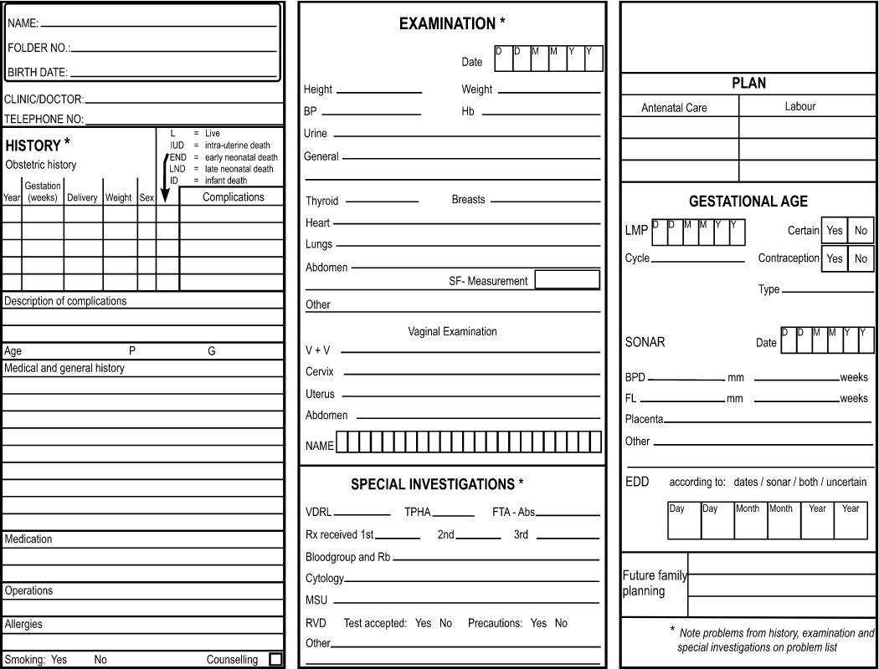
Forms for display

Slide 13
Why use anything other than Forms?
Questionnaire responses aren’t “standard”
Inconsistent over time (different form ‘versions’)
Forms change fairly often
Inconsistent across organizations
Meaning of elements influenced by previous questions
“Address” means different things depending where it appears on the form
In general, can’t query QuestionnaireResponse based on what the answers are

Slide 14
Common pattern
Use forms to capture data
Especially when using ‘simple’ clients
Possibly use ‘population’ to suck in data from existing records
Extract data from form into other resources
Use Provenance to tracker where the data came from
Primarily pass around other resources
Can pass around Provenance and original QuestionnaireResponse if needed

Slide 15
FHIR Form Resources

Slide 16
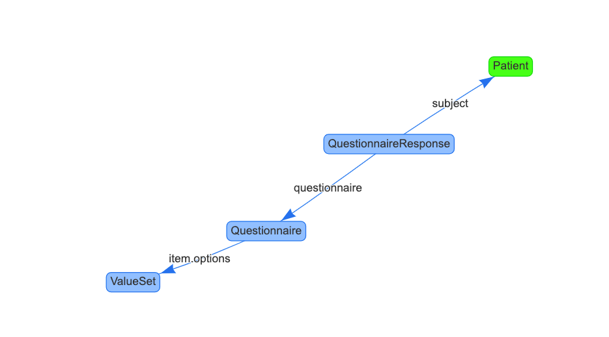
FHIR Questionnaire Artifacts
Questionnaire
Defines the fields in the form
Value Set
Allowed answers
QuestionnaireResponse
Specific set of answers
Other
Extensions, Operations, Profiles, Implementation Guides (incl SDC)
Notes:
Incomparing to StructureDefinition, note that you typically don’t need to profile Questionnaire to create a new form…

Slide 17
Questionnaire
Used to represent forms/surveys/case report forms/etc.
Can capture any sort of information
clinical, administrative, financial, research, public health, …
Hierarchical collections of questions
May include ‘groups’ and instructions/guidance
Control over allowed answer optionality, repetition, data type, options
Some elements might be conditional
e.g. “if question 2=female, then display question 5”

Slide 18
Structure of a Questionnaire
Questionnaire
Metadata
Item
(Group, Question or
Display)

Slide 19
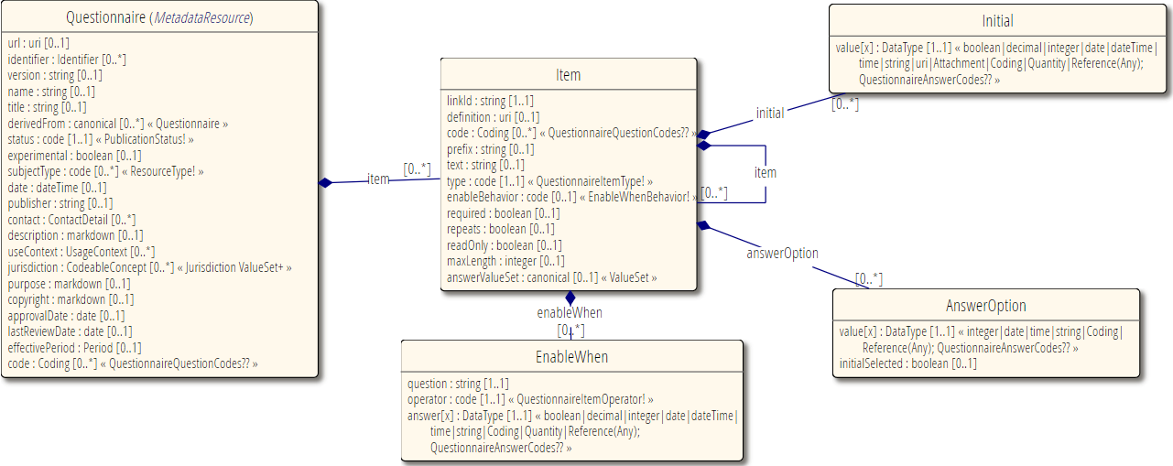
Questionnaire

Slide 20
Types of item
Groups
Organize content of questionnaire
Must have children
Can’t have answers
Questions
Solicit information
Must have answers (but can be optional)
Display
Additional text, no children, no answers

Slide 21
Anatomy of a Question
5.a) What pizza toppings would you like?
(choose at least 1)
Cheese
Ham
Mushrooms
Other
(please specify): ____________
Prefix
Text
Child “display” item (implies required = true, repeats = true)
option or options
Nested “question” item (enableWhen tied to “Other” answer)
Notes:
Options allows you to point to a value set, option allows enumerating individual potential elements

Slide 22
http://hl7.org/fhir/valueset-item-type.html
Item-Type | Response Type | Definition
group | item(Group) | An item with children, may be repeating. Could be a section, table or other layout (e.g. tabs)
display | (none) | Just a label to be displayed (no answer to be collected)
boolean | valueBoolean | Yes/no answer (checkbox, radio group or similar)
decimal | valueDecimal | Real number answer (restricted textbox, slider, …)
integer | valueInteger | Integer answer (restricted textbox, slider, …)
date | valueDate | Date answer (restricted textbox, date picker …)
dateTime | valueDateTime | Date and time answer (restricted textbox, date picker …)
time | valueTime | Time only answer (hour:minute:second) answer independent of date (restricted textbox, …)
string | valueString | Short free-text answer (single line textbox)
text | valueString | Longer free-text answer, potentially multi-paragraph (multi-line textbox)
url | valueUri | URL (website, FTP site, etc.) answer (restricted textbox)
choice | valueCoding | Coding drawn from a list of options (specified in either the option property, or via the ValueSet referenced in the options property) as an answer (radio buttons, checkboxes, combobox, autocomplete …)
open-choice | valueCoding or valueString | Coding drawn from a list of options (as with the choice type) or a free-text entry in a string (similar controls to choice, except with ability to include textbox)
attachment | valueAttachment | Binary content such as a image, PDF, etc. as an answer (file selector …)
reference | valueReference | A reference to another resource, e.g. practitioner, organization, etc. (resource finder?)
quantity | valueQuantity | Question with a combination of a numeric value and unit. ()
Notes:
The relationship between the answer types, user interface control hints, validation properties, and the data that you should expect coming back
Note that some server’s might accept string values coming back, and chose to convert these.
There is an extension 'http://hl7.org/fhir/StructureDefinition/questionnaire-unit' that can be used to define what unit would be captured (or the a unit that has a UCUM conversion from the provided unit)
Also note that the http://hl7.org/fhir/StructureDefinition/questionnaire-itemControl extension also provides additional guidance to a renderer on what controls it would like to be used to best capture the data

Slide 23
Interaction with terminologies
Extensions
Questionnaire structure
questionnaire-optionExclusive
preferredTerminologyServer
questionnaire-unitValueSet
11179-permitted-value-valueset
11179-permitted-value-conceptmap
Operations
Use the ValueSet $expand operation to either pre-load the values, or use the filter parameter for the auto-complete style usage
Item types
Choice, open-choice
Valueset reference (canonical!)
Item.answerValueSet
Answer options
valueCoding
Control selection
Consider the number of potential entries in the list
Checkboxes, radio buttons, comboboxes, autocomplete
Notes:
Open-choice gives the option of recording a free text value.
Resolve to the source of the questionnaire? Fallback to where questionnaire came from if no preferred terminology server is specified

Slide 24
QuestionnaireResponse
A single (fully or partially) completed form
Ties to exactly one Questionnaire*
Every ‘item’ in the QR points to one item in the Q
Lets you see and compare “raw” data

Slide 25
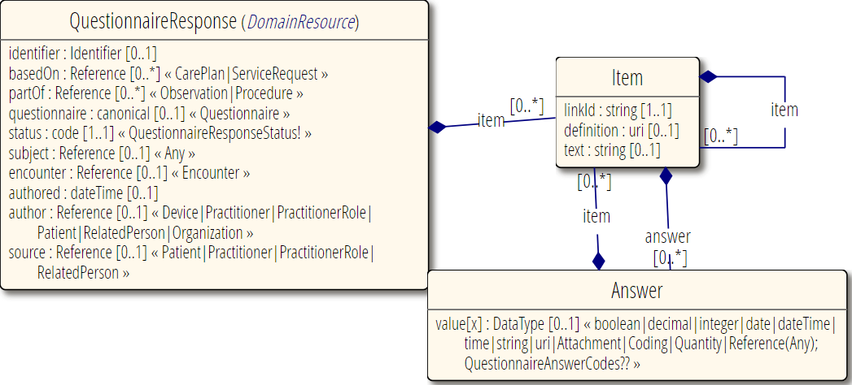
QuestionnaireResponse

Slide 26
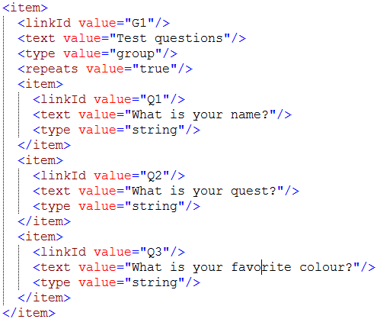
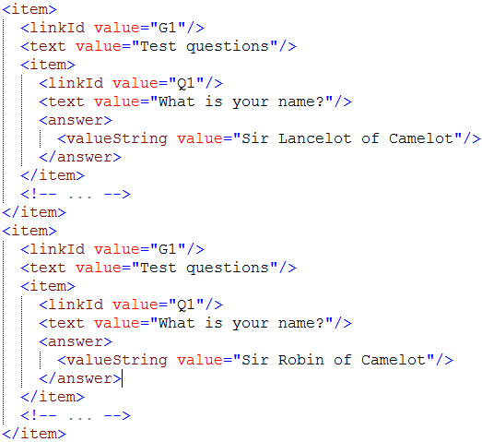
Linking Questionnaire to QuestionnaireResponse
QuestionnaireResponse

Slide 27
Other relevant resources
CodeSystem & ValueSet:
Allow defining sets of answers that are shared or are externally managed
Codes have both computable and human friendly views
Can have numeric weights for calculations
ConceptMap
Allows defining translations for questions
and helpful for mapping QuestionnaireResponses to other resources
StructureMap
Can be used to map Questionnaire

Slide 28
Exercise 1
https://lhcforms.nlm.nih.gov
Complete a QuestionnaireResponse
Using LHC Forms SMART App
Complete a US Surgeon General family health portrait
Think about what item types are used, how the form is structured
Fill in multiple repetitions at each layer possible
Show as QuestionnaireResponse
Look at the accompanying Questionnaire

Slide 29
Exercise 1 - Discussion
Trace the linkage between linkIds in Questionnaire and QuestionnaireResponse
Any questions/discussion topics?

Slide 30
Structured Data Capture

Slide 31
What is Structured Data Capture (SDC)?
Standardize/enhance capabilities of FHIR Questionnaires:
Workflow
Complex form rendering
Complex form behavior
Automatically populating forms
Automatically extracting data from completed forms
Adaptive forms
Form composition

Slide 32
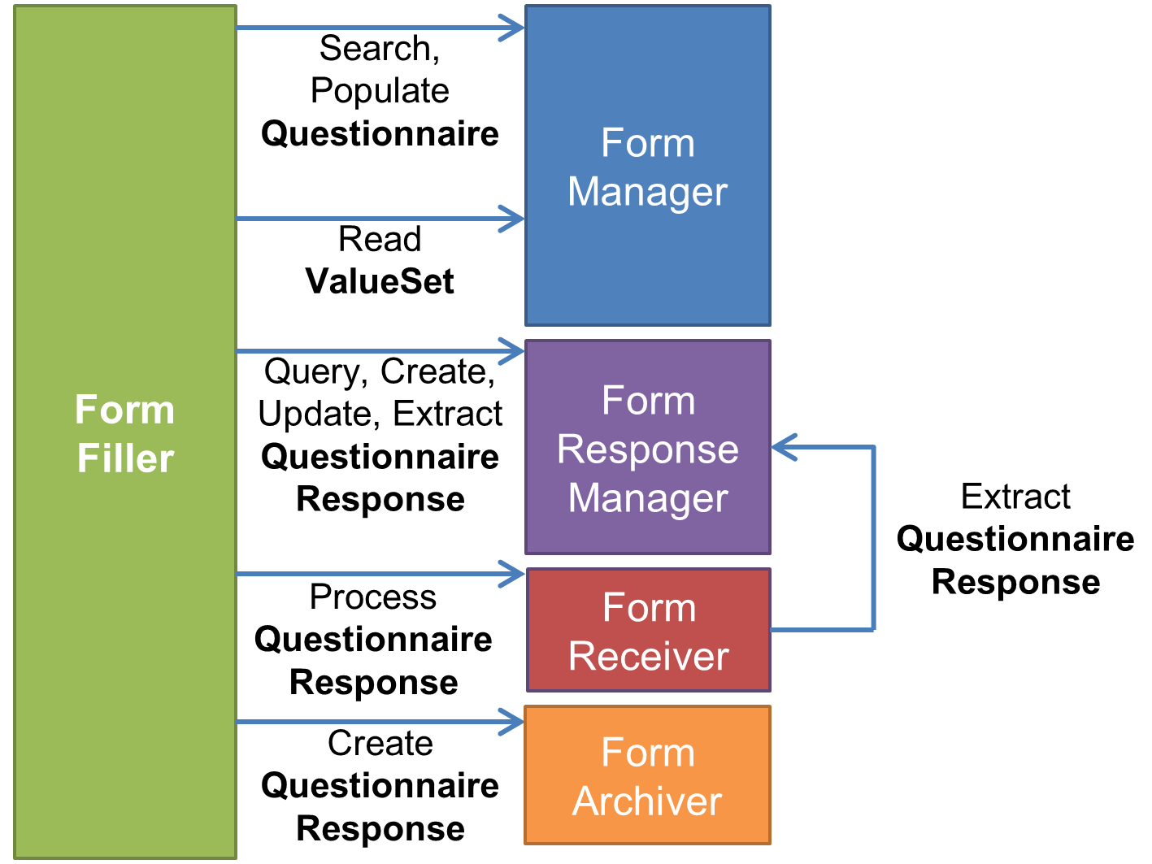
Complex workflow
How do you find a form?
How do you retrieve allowed values?
How do you manage form completion?
How do you submit a form?
How do you ask someone to complete a form?
How do you track whether they’ve filled it out?
How do you derive one form from another?

Slide 33


Complex form rendering
Have questions/instructions render the way you want
Pick at least one green option and no more than one red option
How are you feeling today? is “great”, is “horrible”
Hide or mark certain questions as ‘read only’ (e.g. calculated score)
Should questions be a grid or table? Should a question use a dropdown? Checkboxes? Radio buttons?
And within that, how wide should columns be, what should column headings be, what should the steps on a slider be, etc.
Additional display guidance.
Social Security number:
nnn–nnn-nnn

Slide 34
Complex form behavior
EnableWhen questions based on expressions
If the total score from group 1 > 30, then display these additional cardiology questions
EnableWhen options
Only display “pregnancy” in “reason for absence” if gender = F
Constraints
Can have a maximum of 2 questions with an answer of “most preferred”

Slide 35
Complex form behavior (cont’d)
Constrain values
5-10 characters
January 1-March 30
YYYY-MM
Must be a JPG or PNG, < 500KB
Must be lb or kg
Minimum 3 choices, maximum of 5

Slide 36
Complex form behavior (cont’d)
Constrain references
Answer must be Condition or “Diagnosis Observation”
Possible answers are: Observation?patient=$patient.id&code=12345-5&…
“Click here to create a new value” (launches new questionnaire)

Slide 37
Complex form behavior (cont’d)
Perform calculations (e.g. scores)
Launch context – patient, encounter, etc.
Use CQL or FHIRPath for calculations
Variables, initial expressions
Create forms constructed from other forms

Slide 38
Exploring the SDC spec
http://hl7.org/fhir/uv/sdc

Slide 39
Exercise 2
https://lhcforms.nlm.nih.gov
Create a Questionaire
Using the LHC Form Builder
Create a form that represents the form on the following page

Slide 40
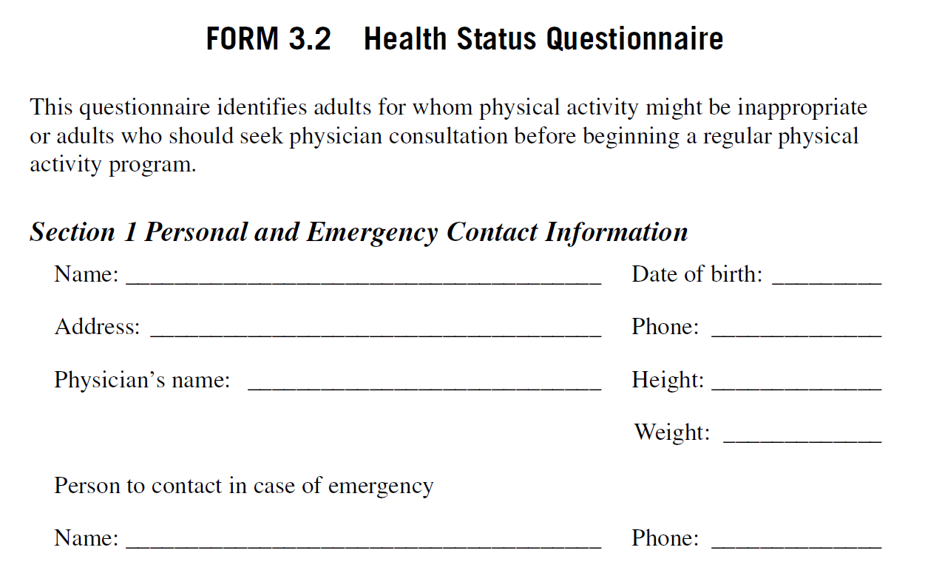
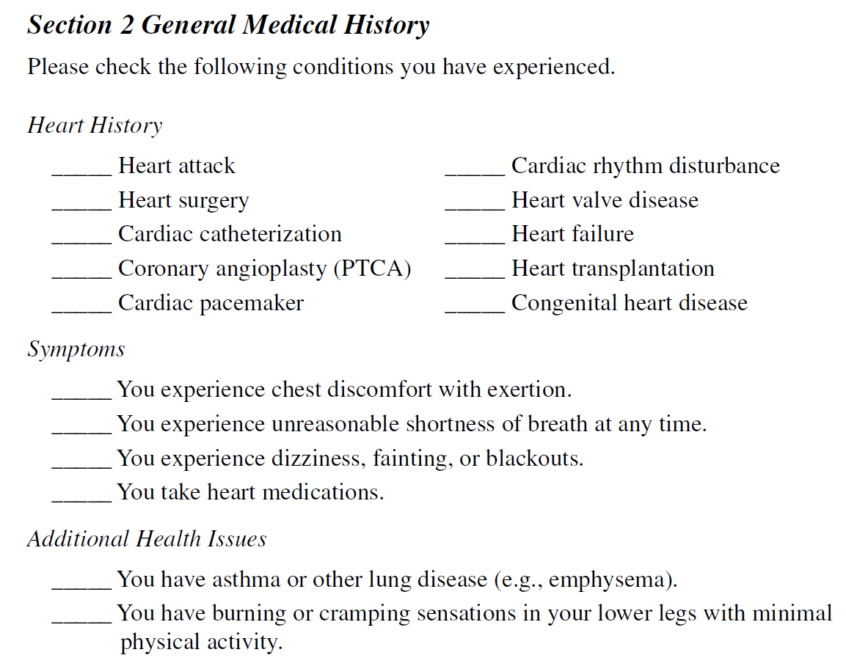
Excerpted from https://www.sampleforms.com/health-questionnaire-form.html

Slide 41
Exercise 2 - discussion
How did you decide what was optional vs. required?
Did you make anything repeating?
How would the design of the form change if you wanted to populate FHIR resources?
Are height & weight each one question or two? Simple type or Quantity?
What codes did you use for medical history?
Does Address make sense as a single field?
How does the rendering of the Questionnaire differ from the original form?

Slide 42
Drilling Down

Slide 43
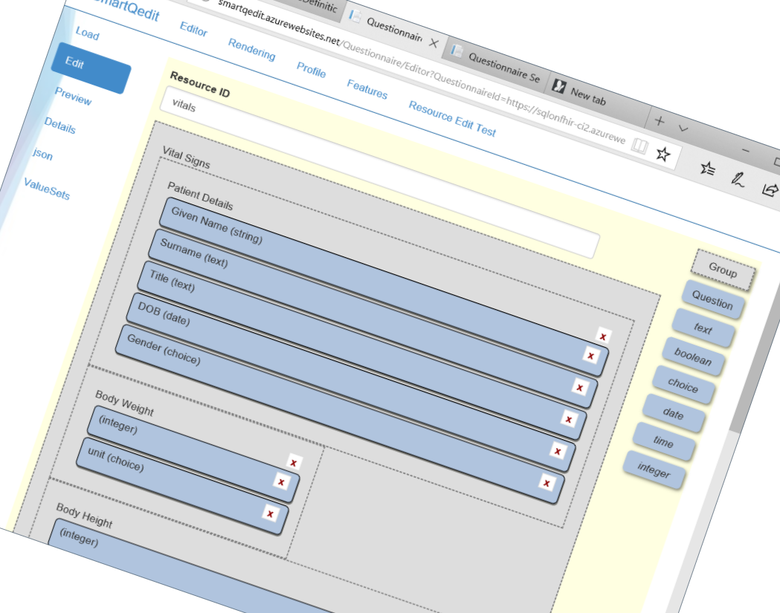
Creating Questionnaires
Converting existing non FHIR definitions
U.S National Library of Medicine's Form Builder for LHC-Forms/FHIR Questionnaire (STU3, R4)
Grahame’s editor
SmartQ editor (DSTU2/STU3 only)
http://smartqedit.azurewebsites.net
Using text editor
Others?
(or combination of the above)

Slide 44
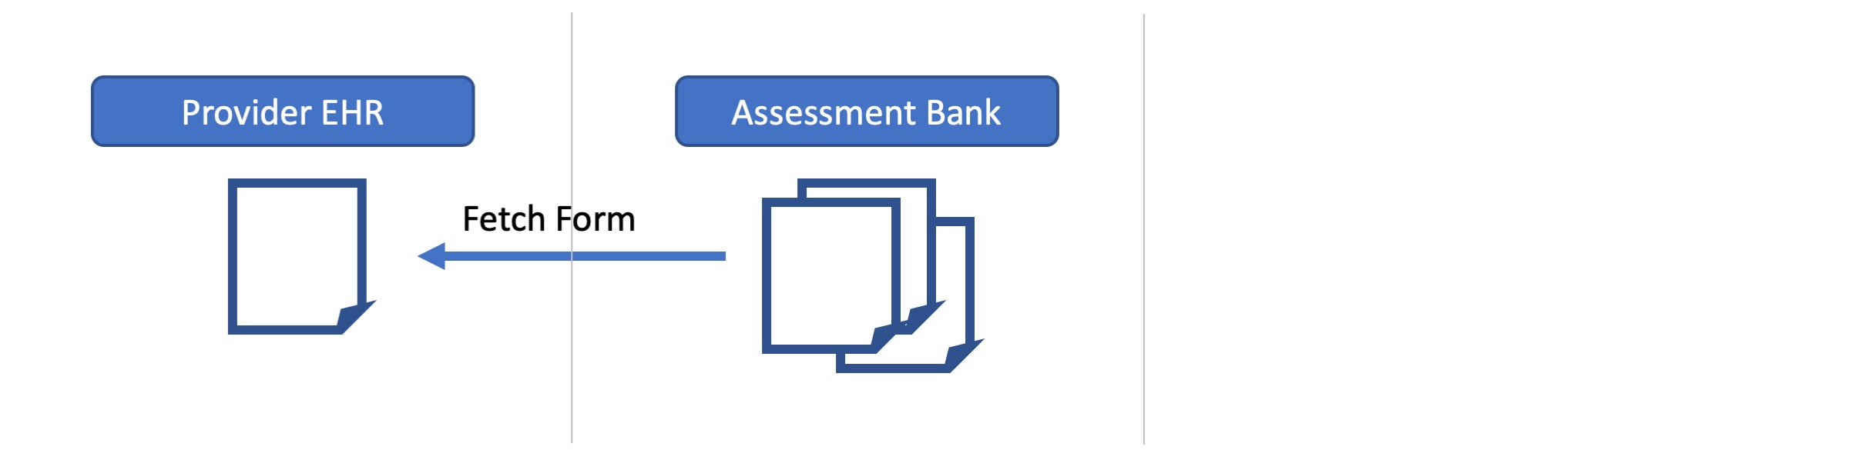
Fetching Questionnaires
Standard FHIR Search API
e.g., by id, title, publisher, context, etc.
Through references in a directory
Notes:
Fully described in Argonaut Questionnaire IG: http://www.fhir.org/guides/argonaut/questionnaire/static.html
These could also be referenced in a directory – this area is still being refined, and is not currently profiled in the Core FHIR specification

Slide 45

Validation
FHIR json/xml valid (serialization)
Core FHIR profile validation (maybe local profiles too)
QuestionnaireResponse validation
Item Types (using linkId to match)
Extensions/Extended Validation
Base Questionnaires through derivedFrom reference
Custom validation?
OperationOutcome
Content/messages appropriate to display to users?
Notes:
Note that the questionnaire might be contained, or referenced

Slide 46

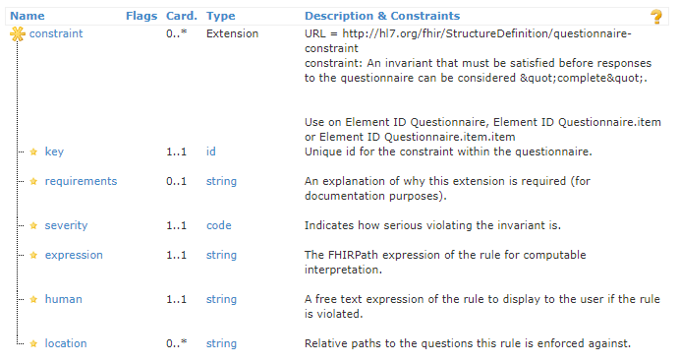
Advanced Validation
Core resources can be profiled with invariants
Extension adds this capability to Questionnaires
http://hl7.org/fhir/extension-questionnaire-constraint.html
Notes:
Of course these invariants would be great if you could validate these when you’re saving these too into the questionnaire
This is using the same FHIRPath language that invariants use

Slide 47
Advanced Validation Examples
Checking cross field validation
Checking conditional rules
Checking complex calculations
Error messages
https://sqlonfhir-r4.azurewebsites.net/fhir/Questionnaire/sa-rtw-r4
Notes:
TBD: Migrate the RTW form to demonstrate the validation rules

Slide 48
Pre-population
Requires:
context/source
mapping
processing engine
Knowledge of source structures (particularly profiled scope)

Slide 49
Pre-population
Current $populate Options:
Observation based
FHIRPath based
StructureMap based

Slide 50

Pre-population – Observation based
Low flexibility of Questionnaire structure in mapping
Source
Context may be provided in parameter, or SMART
Item.code for LOINC/SNOMED/other to search
Extension questionnaire-observationLinkPeriod to define range to check for last observation to read
Mapping
Item.code for LOINC/SNOMED/other for the values to be extracted from the observation
Groups can be used for extracting observation components
If the system understands that codings like LOINC 21112-8 is patient.birthDate, then it may extract data like this also
Notes:
Need to take care with DataElements as this is changing in R4

Slide 51
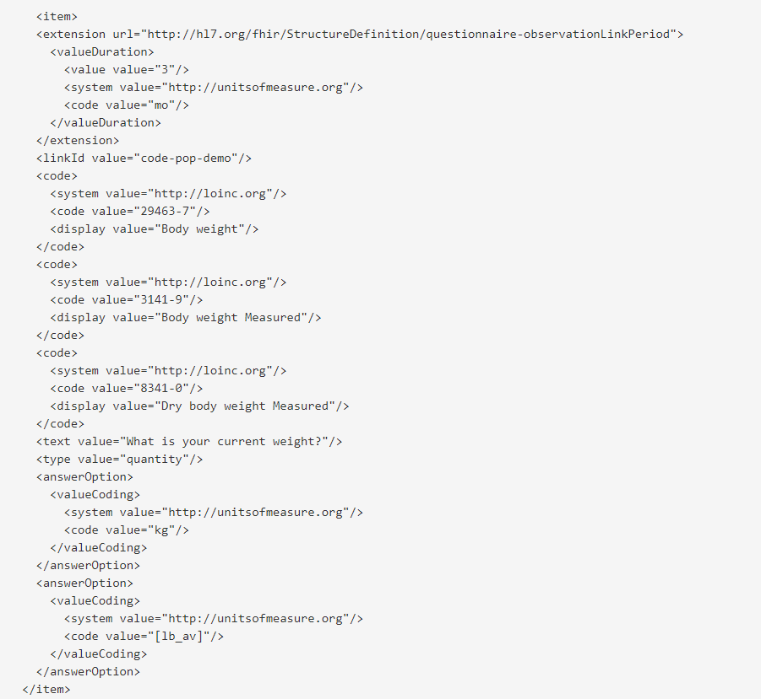
During the pre-population stage, this is the query that could be produced to extract the data:
(assuming that the date of 3 months ago was 2020-06-02)
[base]?Observation?subject=[questionnaire response subject id]
&code=http%3A//loinc.org|29463-7,http%3A//loinc.org|3141-9, http%3A//loinc.org|8341-0
&status=completed
&date=ge2020-06-02
&_sort=-date
&_count=1

Slide 52
Pre-population – FHIRPath based
Source
Context may be provided in parameter, or SMART
extension questionnaire-launchContext
Produces a bundle for processing
Mapping
FHIR Path expressions for each property to map
extension “questionnaire-itemContext”
Extension “sdc-questionnaire-initialExpression”
Leverage variables to assist in calculations
Extension “variable” uses Expression datatype
More Flexible, requires knowledge of FHIRPath and FHIR Queries to create the mappings
Notes:
Need to take care with DataElements as this is changing in R4
http://hl7.org/fhir/uv/sdc/StructureDefinition/sdc-questionnaire-initialExpression

Slide 53
Conversion/Mapping to other resources
http://build.fhir.org/ig/HL7/sdc/extraction.html
Observation based extraction
Item.code for LOINC/SNOMED/other codings for the values to be extracted
groups can create components in the observation too
Definition based extraction (http://hl7.org/fhir/questionnaire.html#2.38.5.4)
item.definition directly links to an element in a structure definition e.g. http://hl7.org/fhir/StructureDefinition/Observation#Observation.comment
Can link each item, supporting repeating items!
Caveat: can’t do complex split/join/calculations, and shape of questionnaire must closely match StructureDefinition
StructureMap based extraction
Explicit mappings for every property
Uses the FHIR mapping language, can be very complex but flexible, it is a transform language
Use the questionnaire-targetStructureMap extension on the questionnaire
Notes:
https://sqlonfhir-ci2.azurewebsites.net/fhir/Questionnaire/edit-org

Slide 54
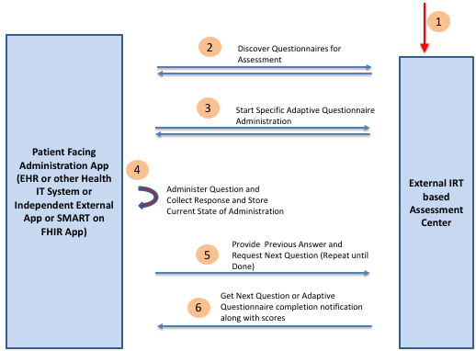
Adaptive forms
Q:What is your name?
A: Arthur
Q: What is your quest?
A: Holy Grail
Q: What is the air-speed velocity of an unladen swallow?
A:
54125-0
86505-5
86508-9
Notes:
The LOINC codes were added after the fact when Dan Vreeman pointed out that there are standard codes for these questions ☺

Slide 55
Compositional forms
How can designers encourage re-use with forms?
Composition with sub-forms
Create forms referencing only data elements
$build to instantiate the full-blown Questionnaire

Slide 56
Exercise 3
https://lhcforms.nlm.nih.gov
Update the previously authored form to use ‘population’
Test the form in the LHC Forms SMART app
(Do this working together)

Slide 57
Timeline
STU 3 published
Plan to re-ballot Fall 2023
Corrections & clarifications
Migrate draft content to STU
2024 – create an R5 release of SDC

Slide 58




Questions / Discussion
lloyd@dogwoodhealthconsulting.com
http://hl7.org/fhir/uv/sdc
Or, better yet, include the community and ask/discuss on chat.fhir.org

